Slide 1
Set Up E-MailRelay
Lecturer: Ngo Huy Bien
Software Engineering Department
Faculty of Information Technology
VNUHCM - University of Science
Ho Chi Minh City, Vietnam
nhbien@fit.hcmus.edu.vn

Slide 2

Objectives

Slide 3

Contents

Slide 4

References

Slide 5
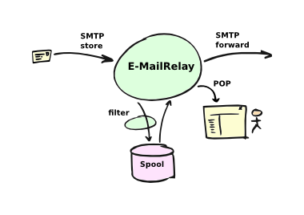
E-MailRelay
http://emailrelay.sourceforge.net/
https://sourceforge.net/projects/emailrelay/
https://github.com/aclemons/emailrelay
E-MailRelay is an e-mail store-and-forward message transfer agent and proxy server. It runs on Unix-like operating systems (including Linux and Mac OS X), and on Windows.
E-MailRelay does three things:
it stores any incoming e-mail messages that it receives,
it forwards e-mail messages on to another remote e-mail server, and
it serves up stored e-mail messages to local e-mail reader programs.
More technically, it acts as
a SMTP storage daemon,
a SMTP forwarding agent, and
a POP3 server.

Slide 6
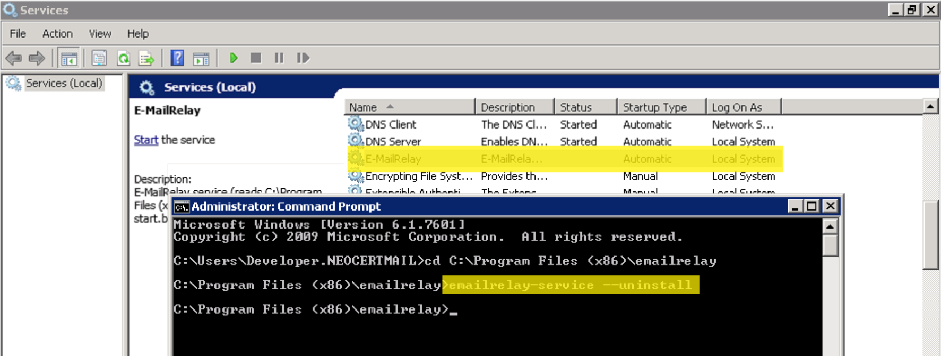
1. Uninstall E-MailRelay
http://emailrelay.sourceforge.net/index.html#windows_md_Uninstall
Stop the program and/or the service
Uninstall the service, if installed
cd "C:\Program Files\E-MailRelay"
emailrelay-service --remove

Slide 7
2. Delete E-MailRelay Files
Delete the files from the E-MailRelay program files folder (eg. C:\Program Files\E-MailRelay).
Delete the files from the E-MailRelay program data folder (eg. C:\ProgramData\E-MailRelay).
Delete any desktop shortcuts (eg. %USERPROFILE%\Desktop\E-MailRelay.lnk).
Delete any start menu shortcuts (eg. %APPDATA%\Microsoft\Windows\Start Menu\Programs\E-MailRelay.lnk).
Delete any auto-start shortcuts (eg. %APPDATA%\Microsoft\Windows\Start Menu\Programs\Startup\E-MailRelay.lnk).
Clean up the registry under HKLM\System\CurrentControlSet\Services\EventLog\Application\emailrelay.

Slide 8


Slide 9
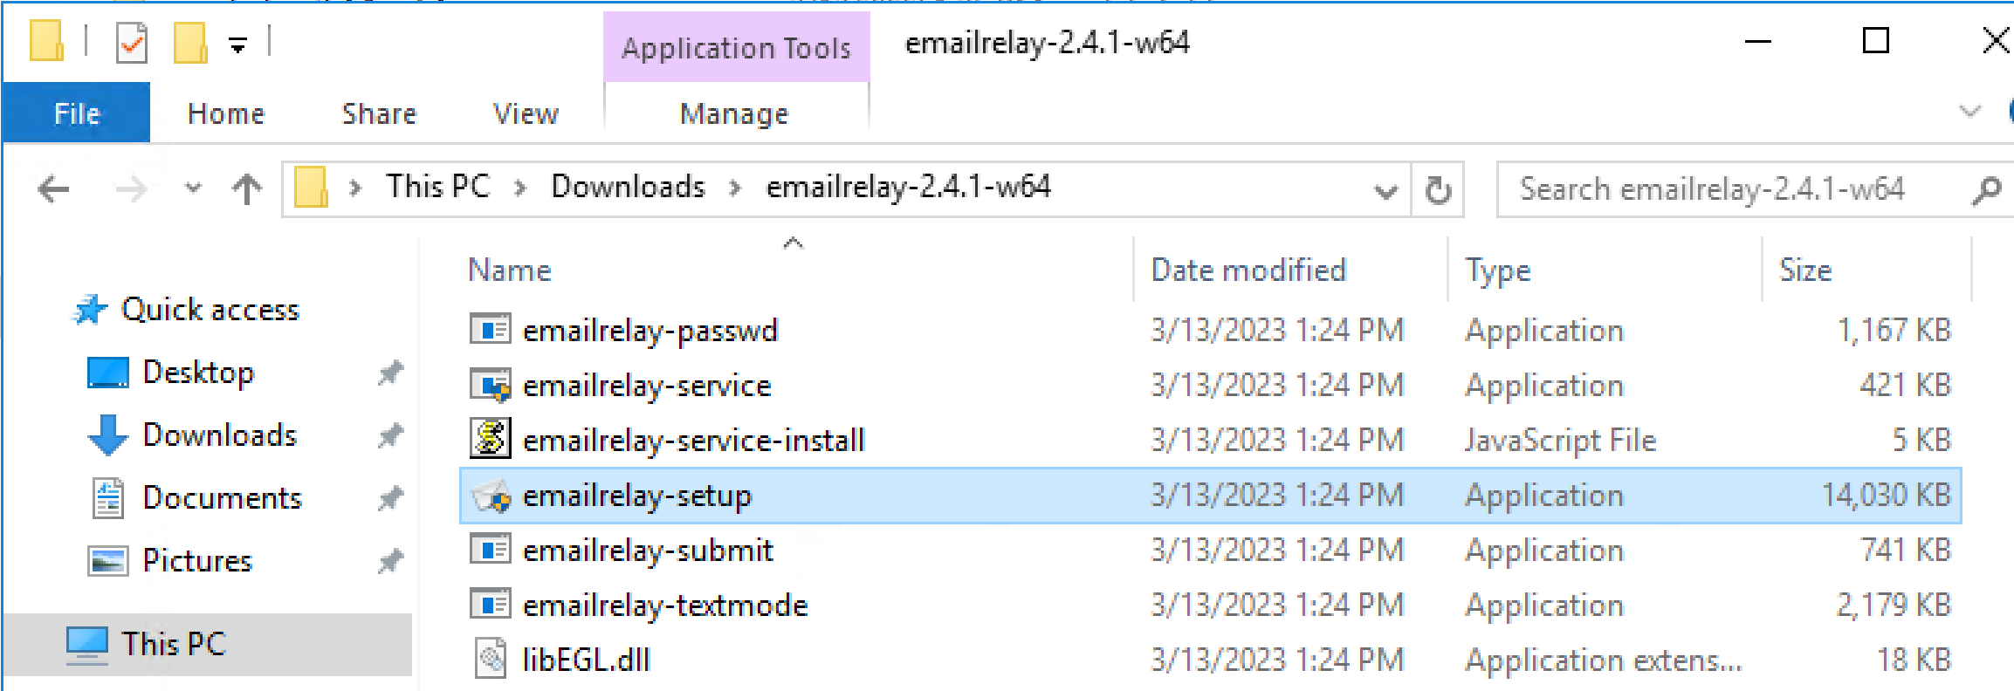
1. Download E-MailRelay
https://sourceforge.net/projects/emailrelay/files/OldFiles/
Click on emailrelay-2.4.1-w64.zip link.
Extract the zip file.
Click on the emailrelay-setup.exe file.

Slide 10
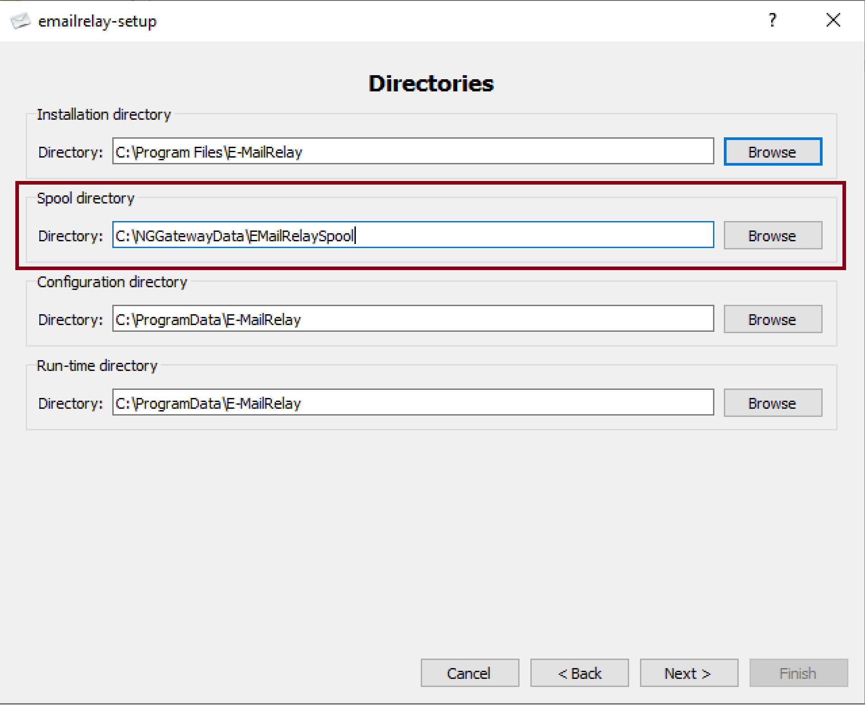
2. Select Spool Directory
This is where inbound messages are stored.

Slide 11
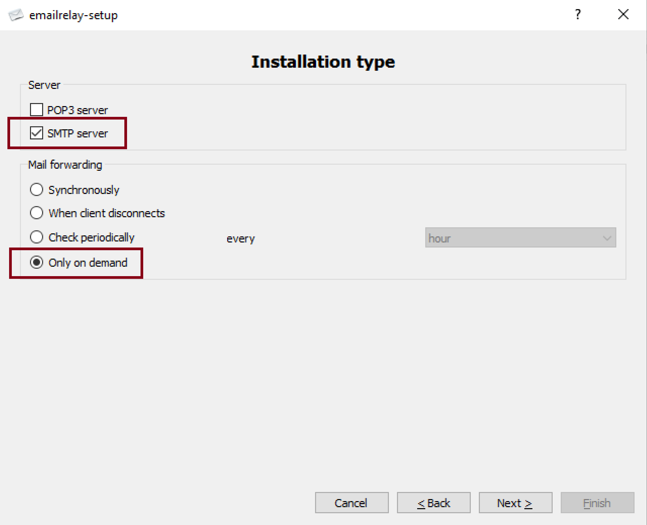
3. Enable SMTP Server

Slide 12
4. Enter SMTP Port and Connection Credentials
Guardian / Gateway@2023
TLS requires the host name for verifying certificates. Therefore the host name must match the certificate.
https://www.sslshopper.com/ssl-converter.html

Slide 13
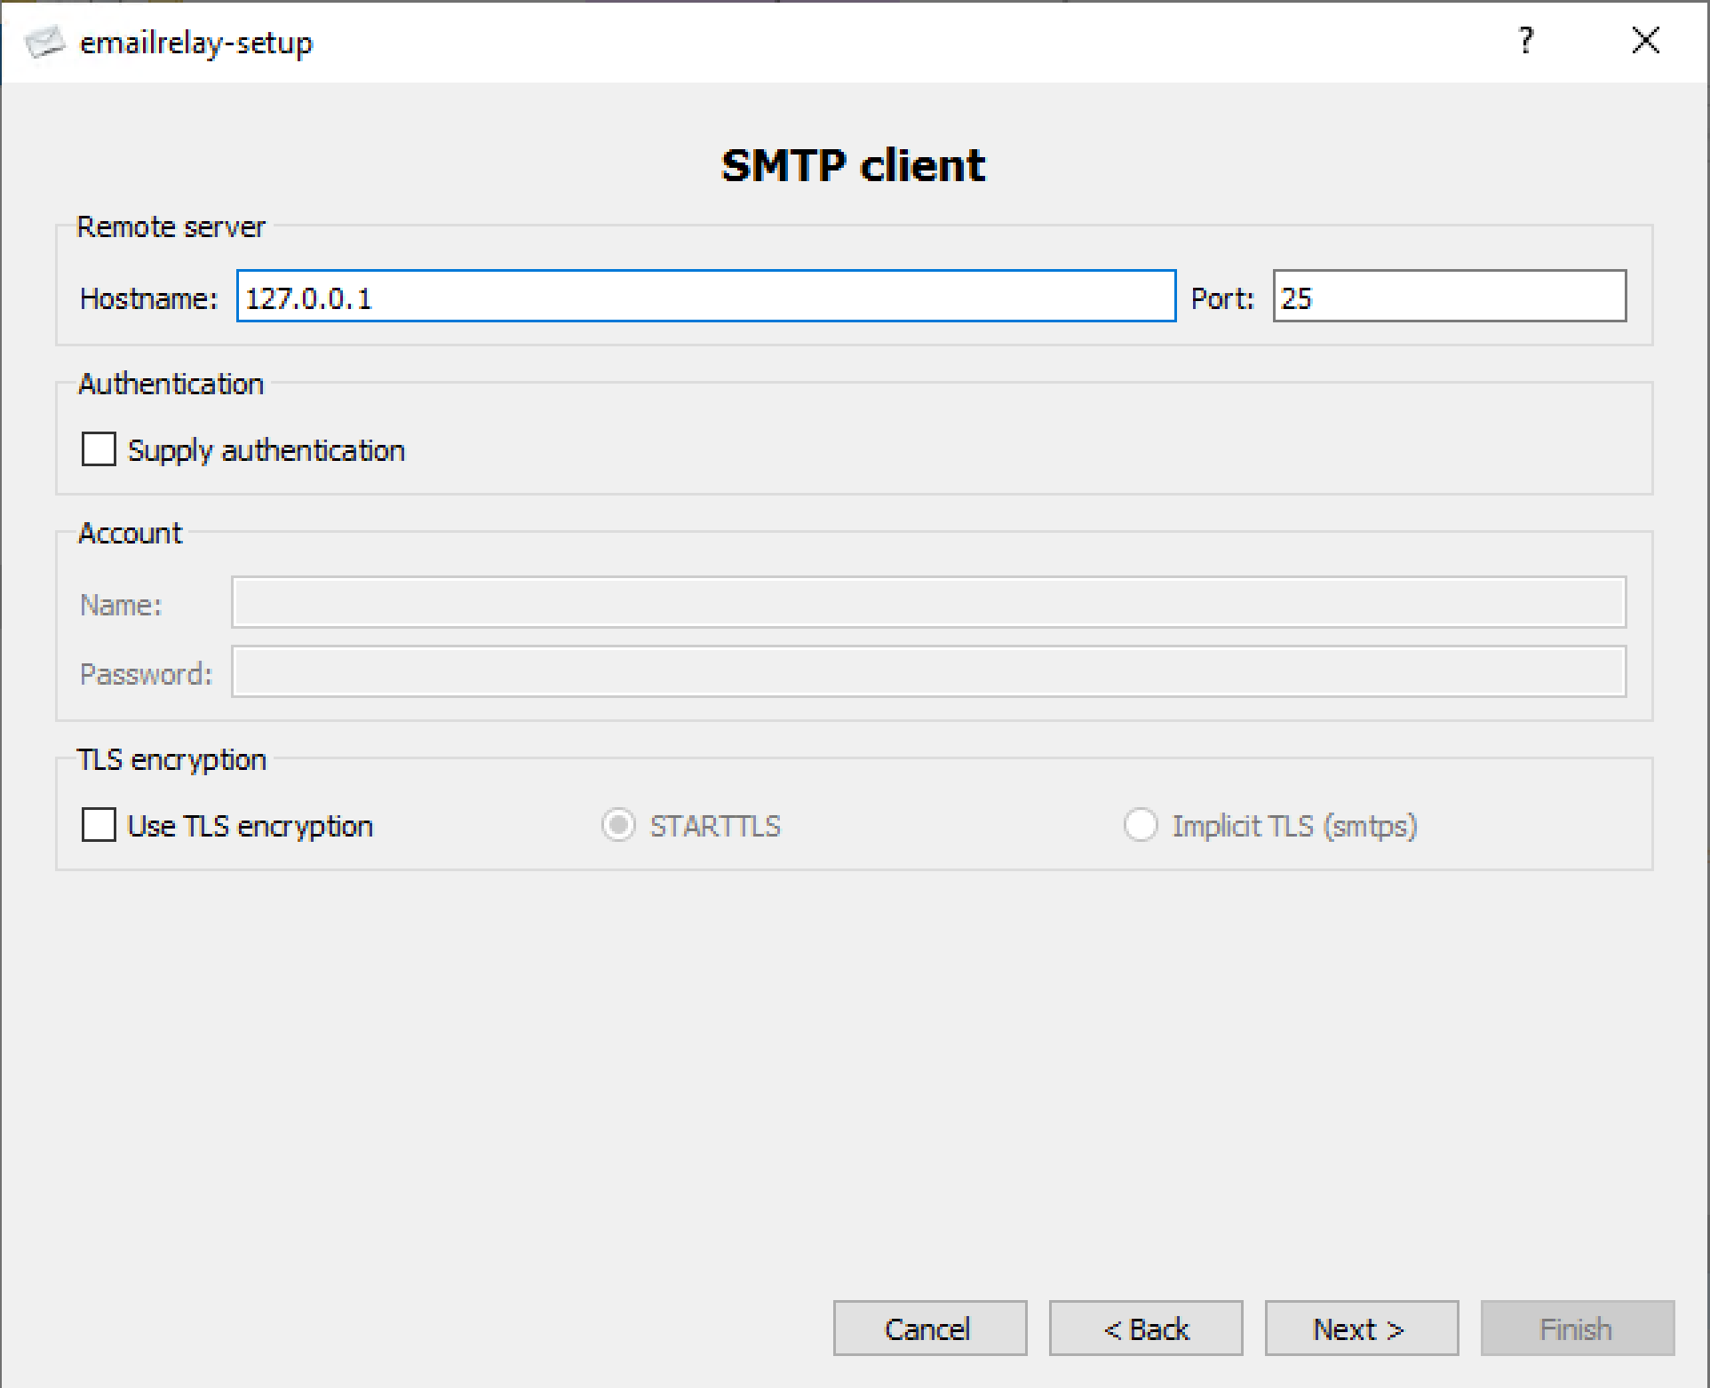
5. Enter External SMTP Information
For forwarding messages.

Slide 14
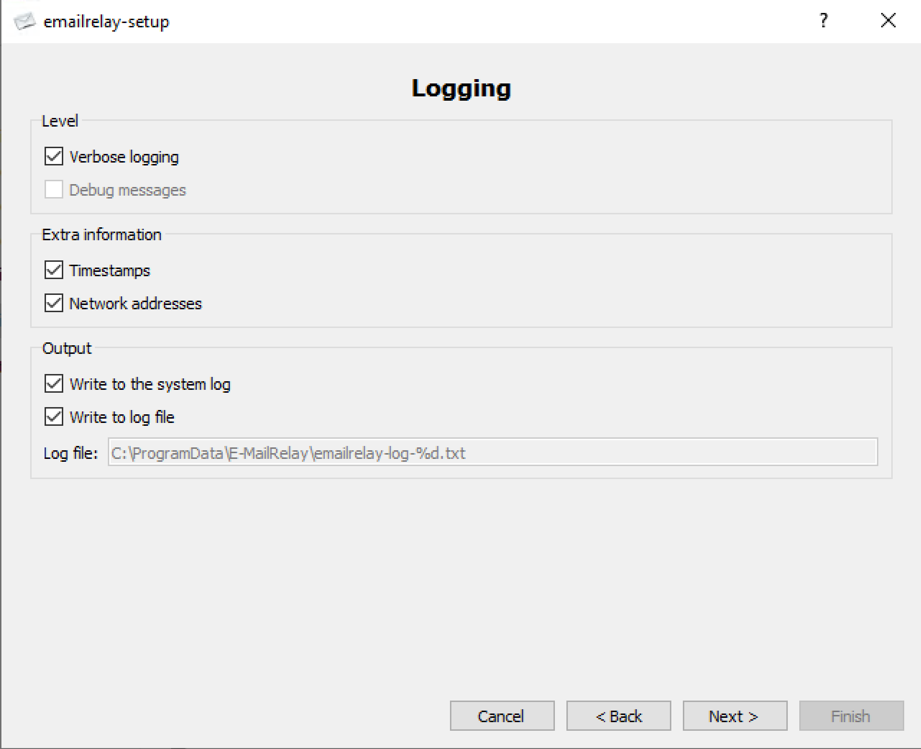
6. Enable Logging

Slide 15
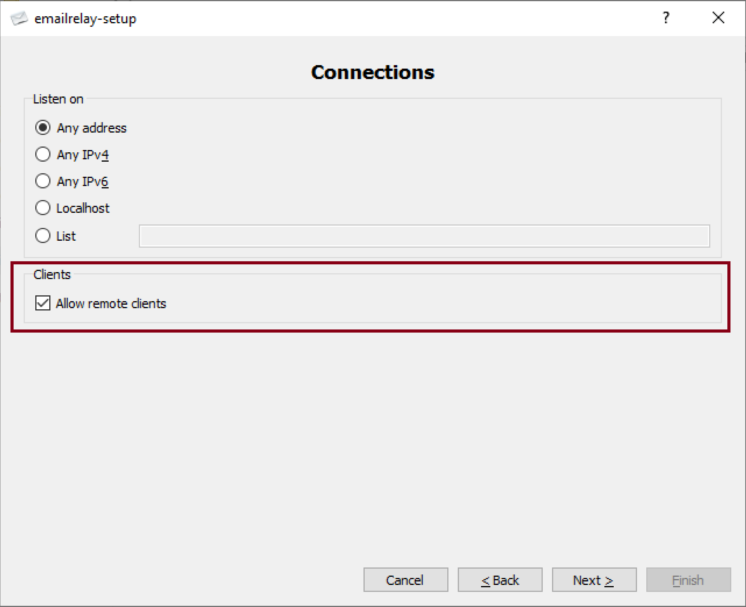
7. Allow Remote Clients

Slide 16
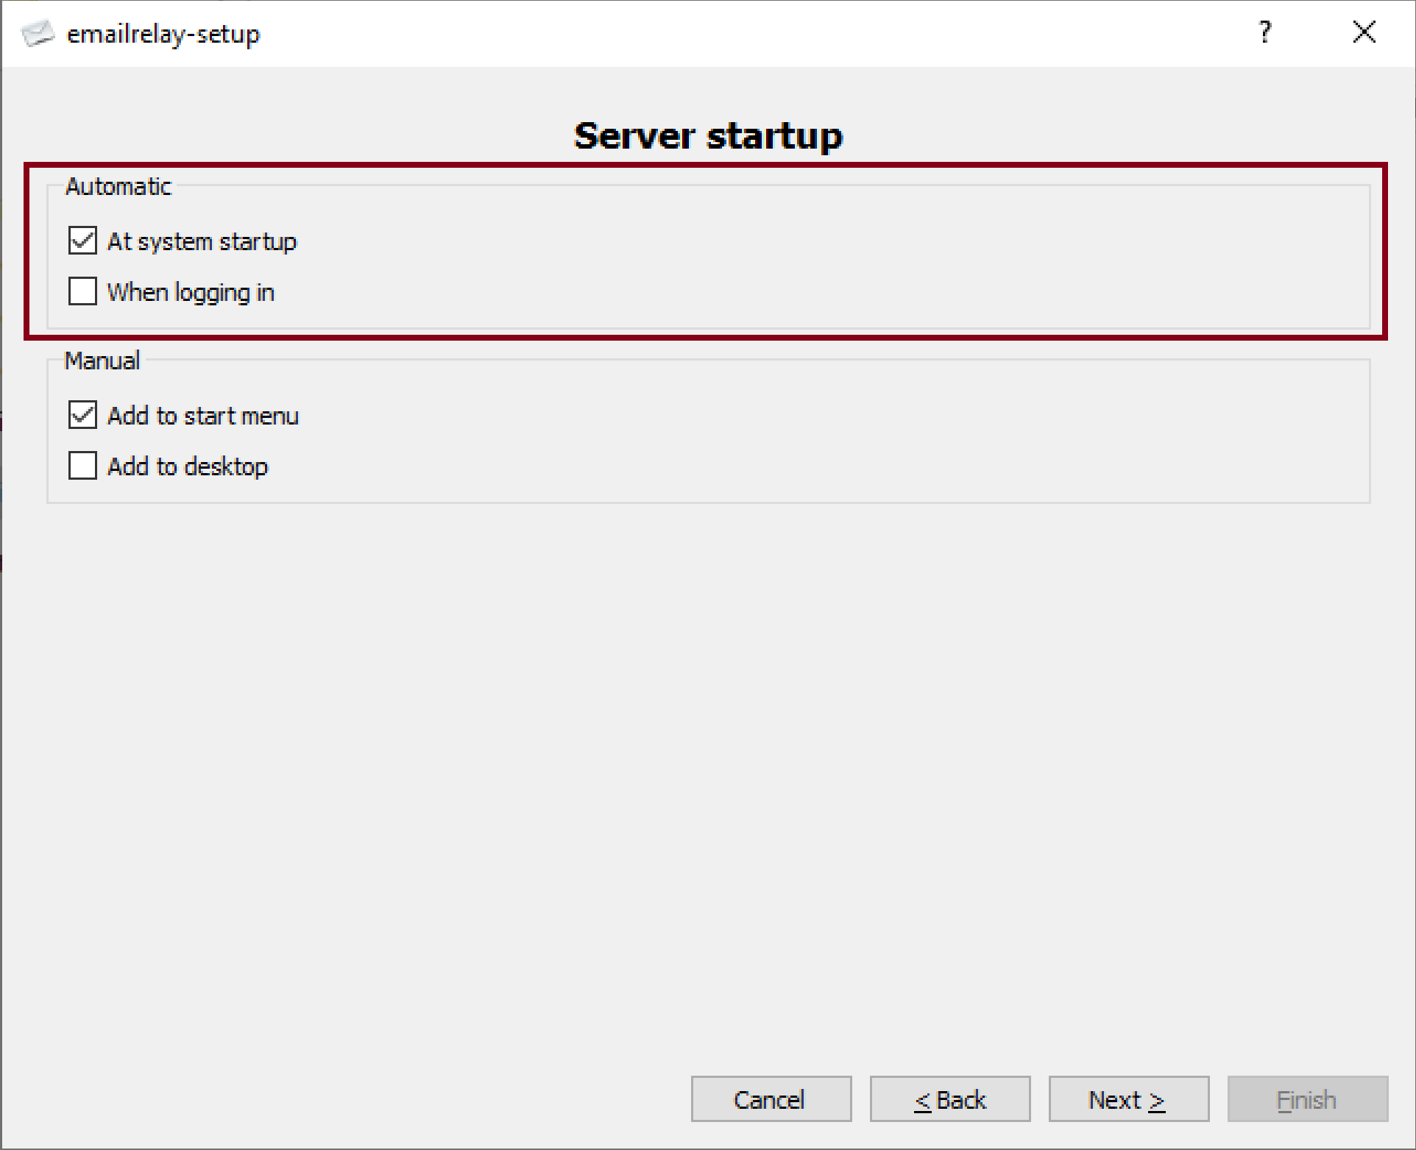
8. Enable Windows Service

Slide 17
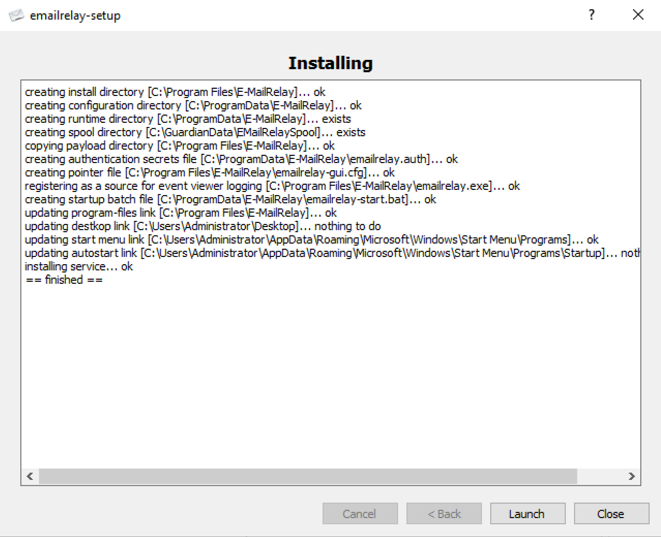
9. Launch Service

Slide 18
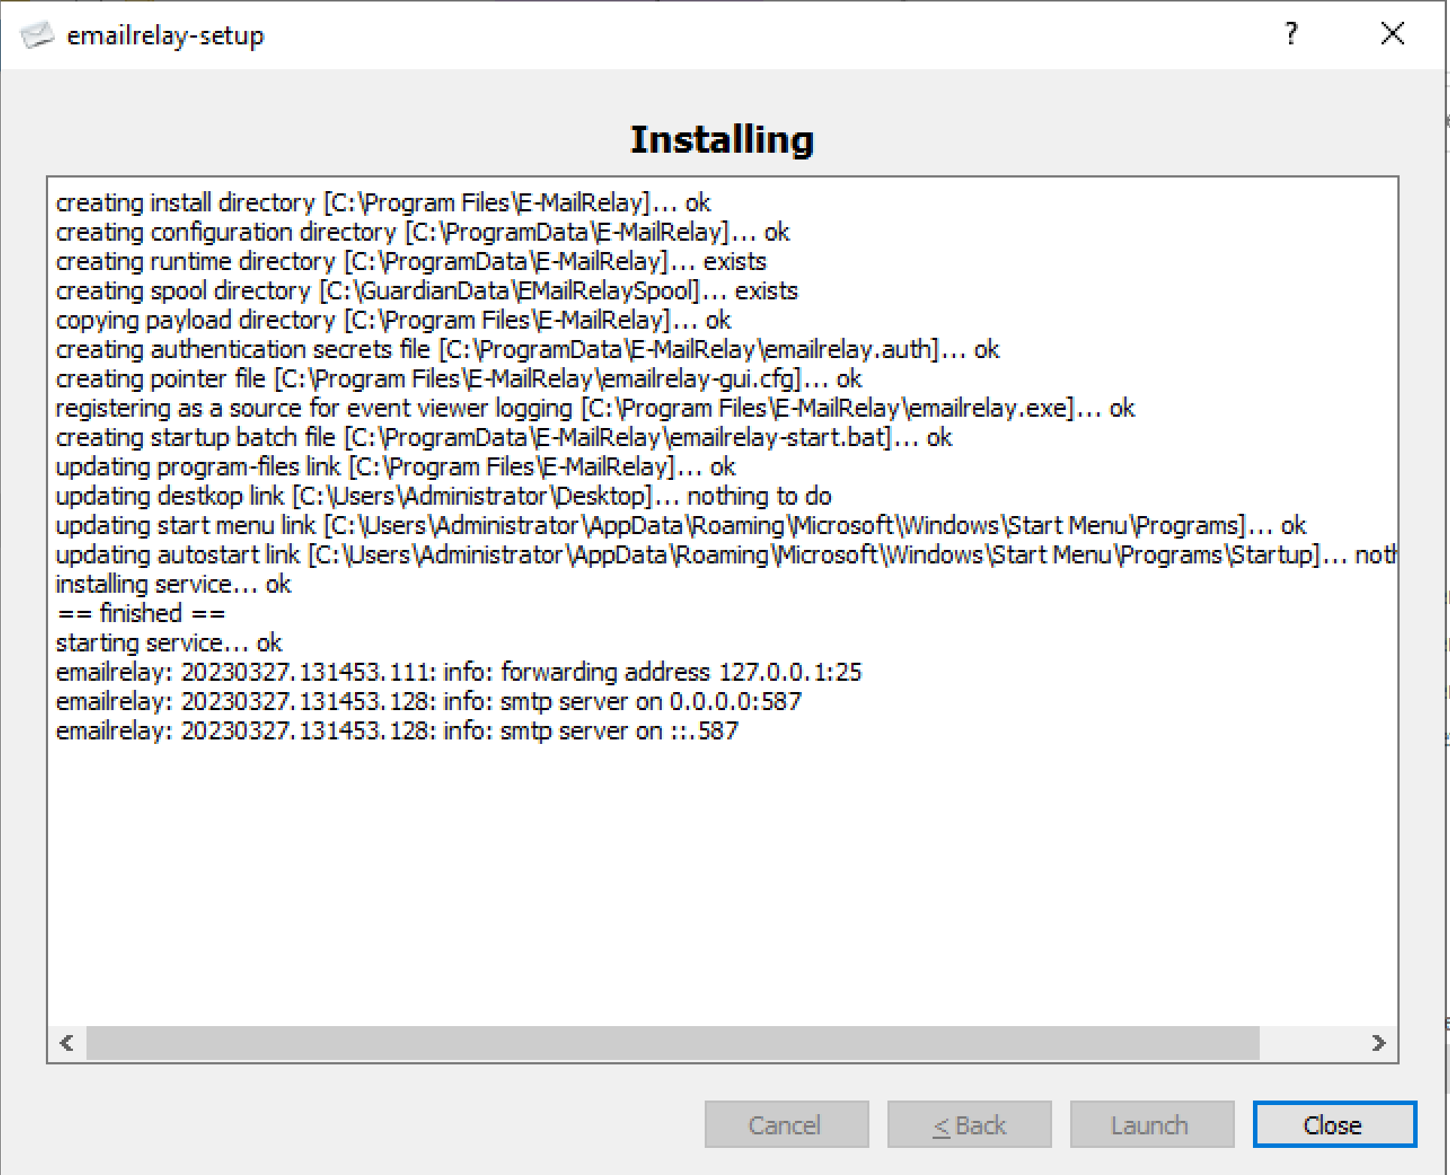
10. Review Result

Slide 19
11. Verify TLS Support
Open C:\ProgramData\E-MailRelay\.
Open emailrelay-start.bat.
Check below parameter in the file.
--server-tls --server-tls-certificate C:\NGGatewayData\certs\wildcard_example_com.pem

Slide 20
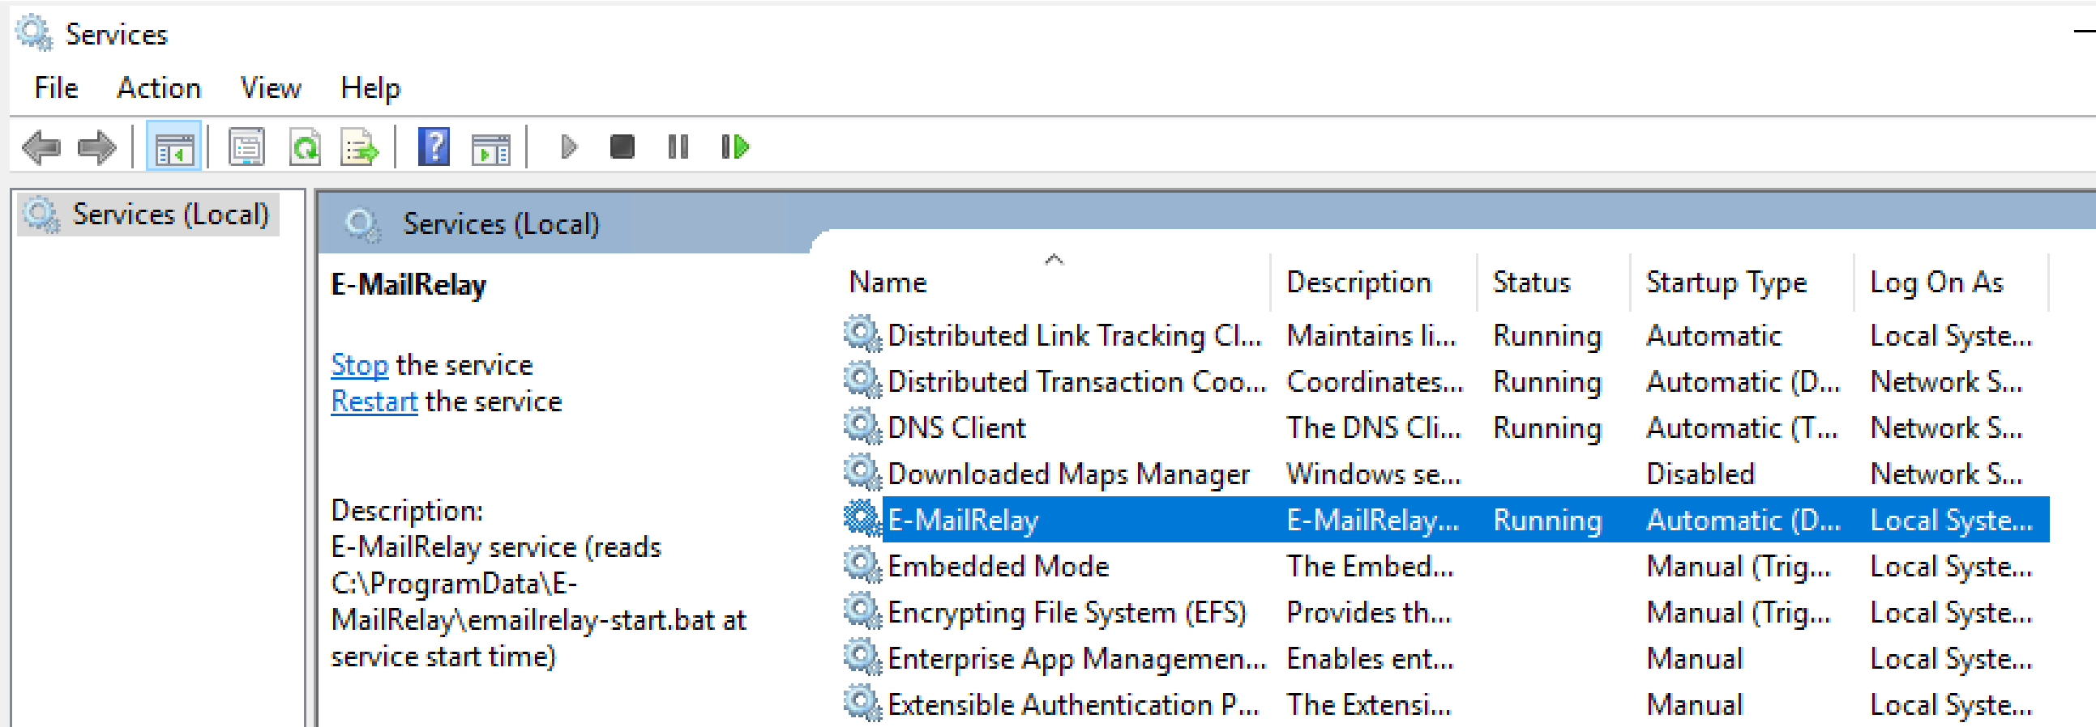
12. Verify Service Status

Slide 21
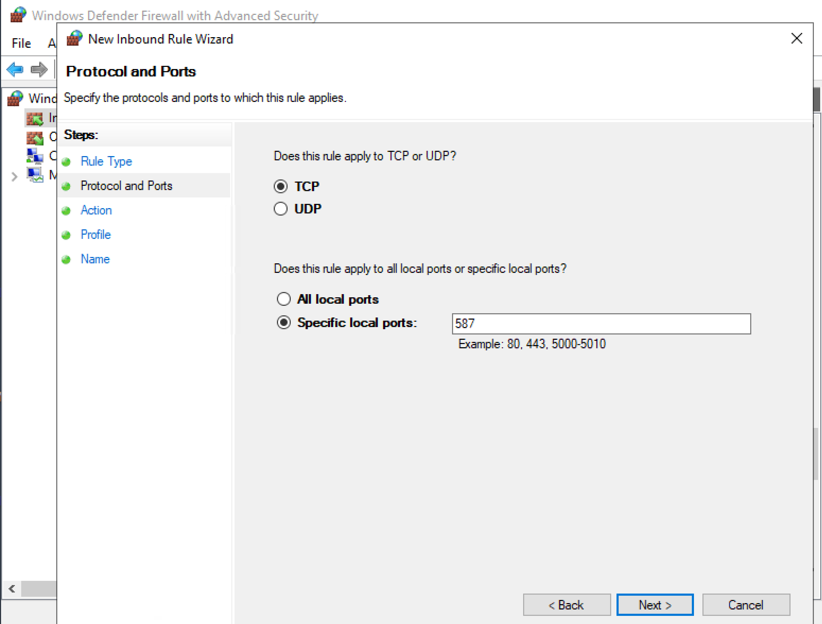
13. Enable Inbound Port 587 in Local Firewall

Slide 22
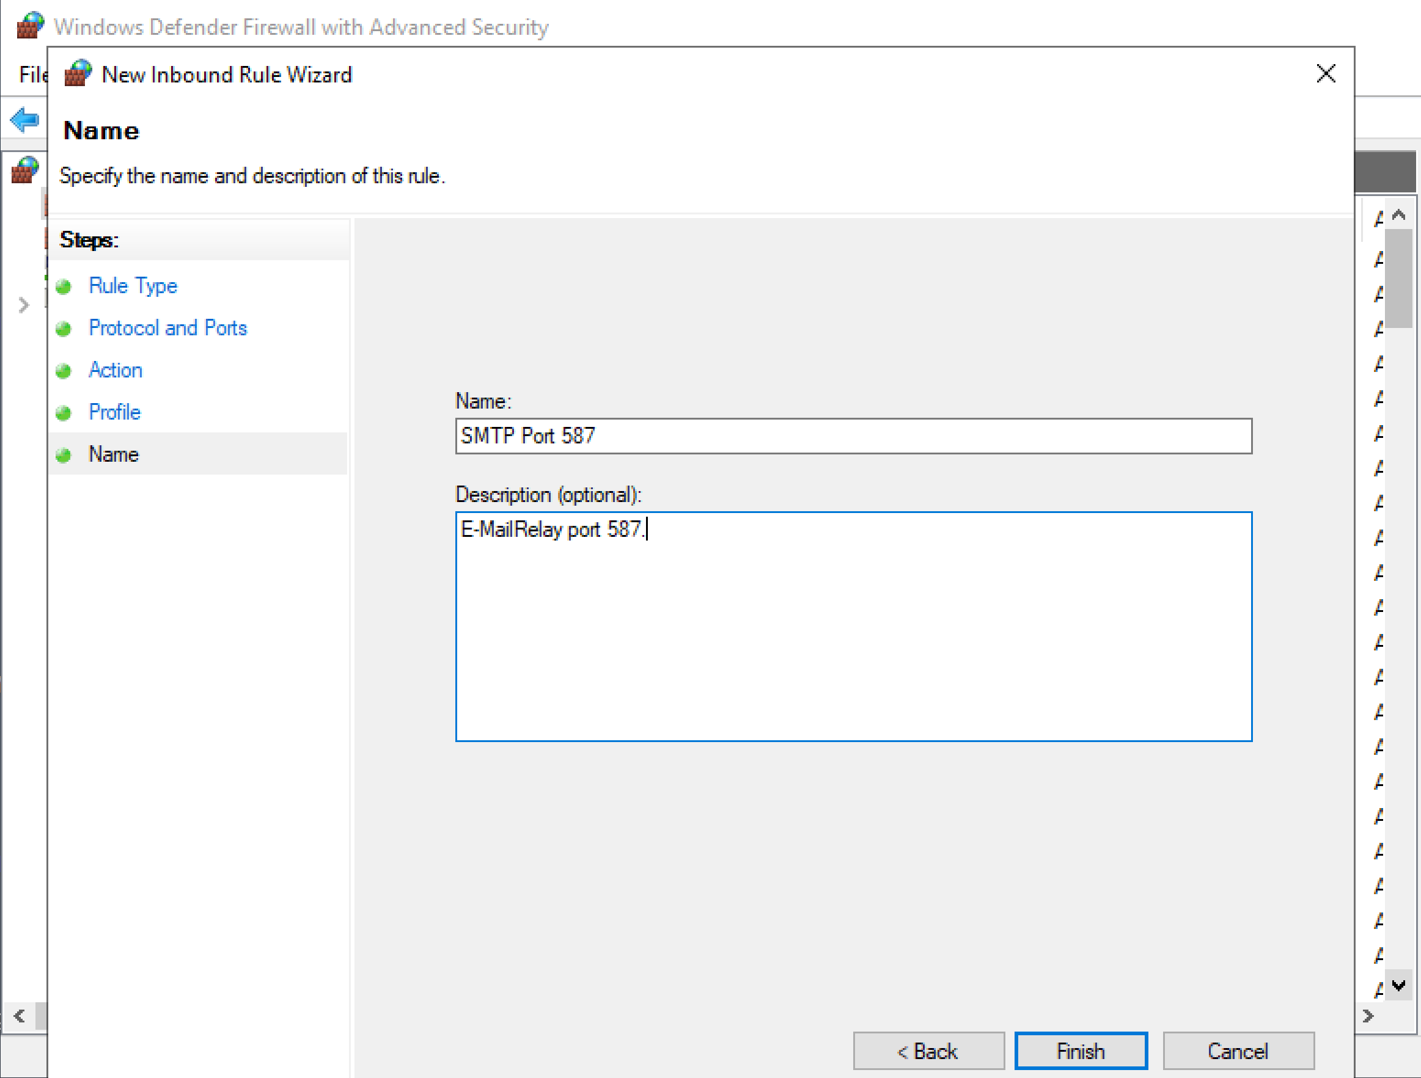
14. Enter Rule Name

Slide 24
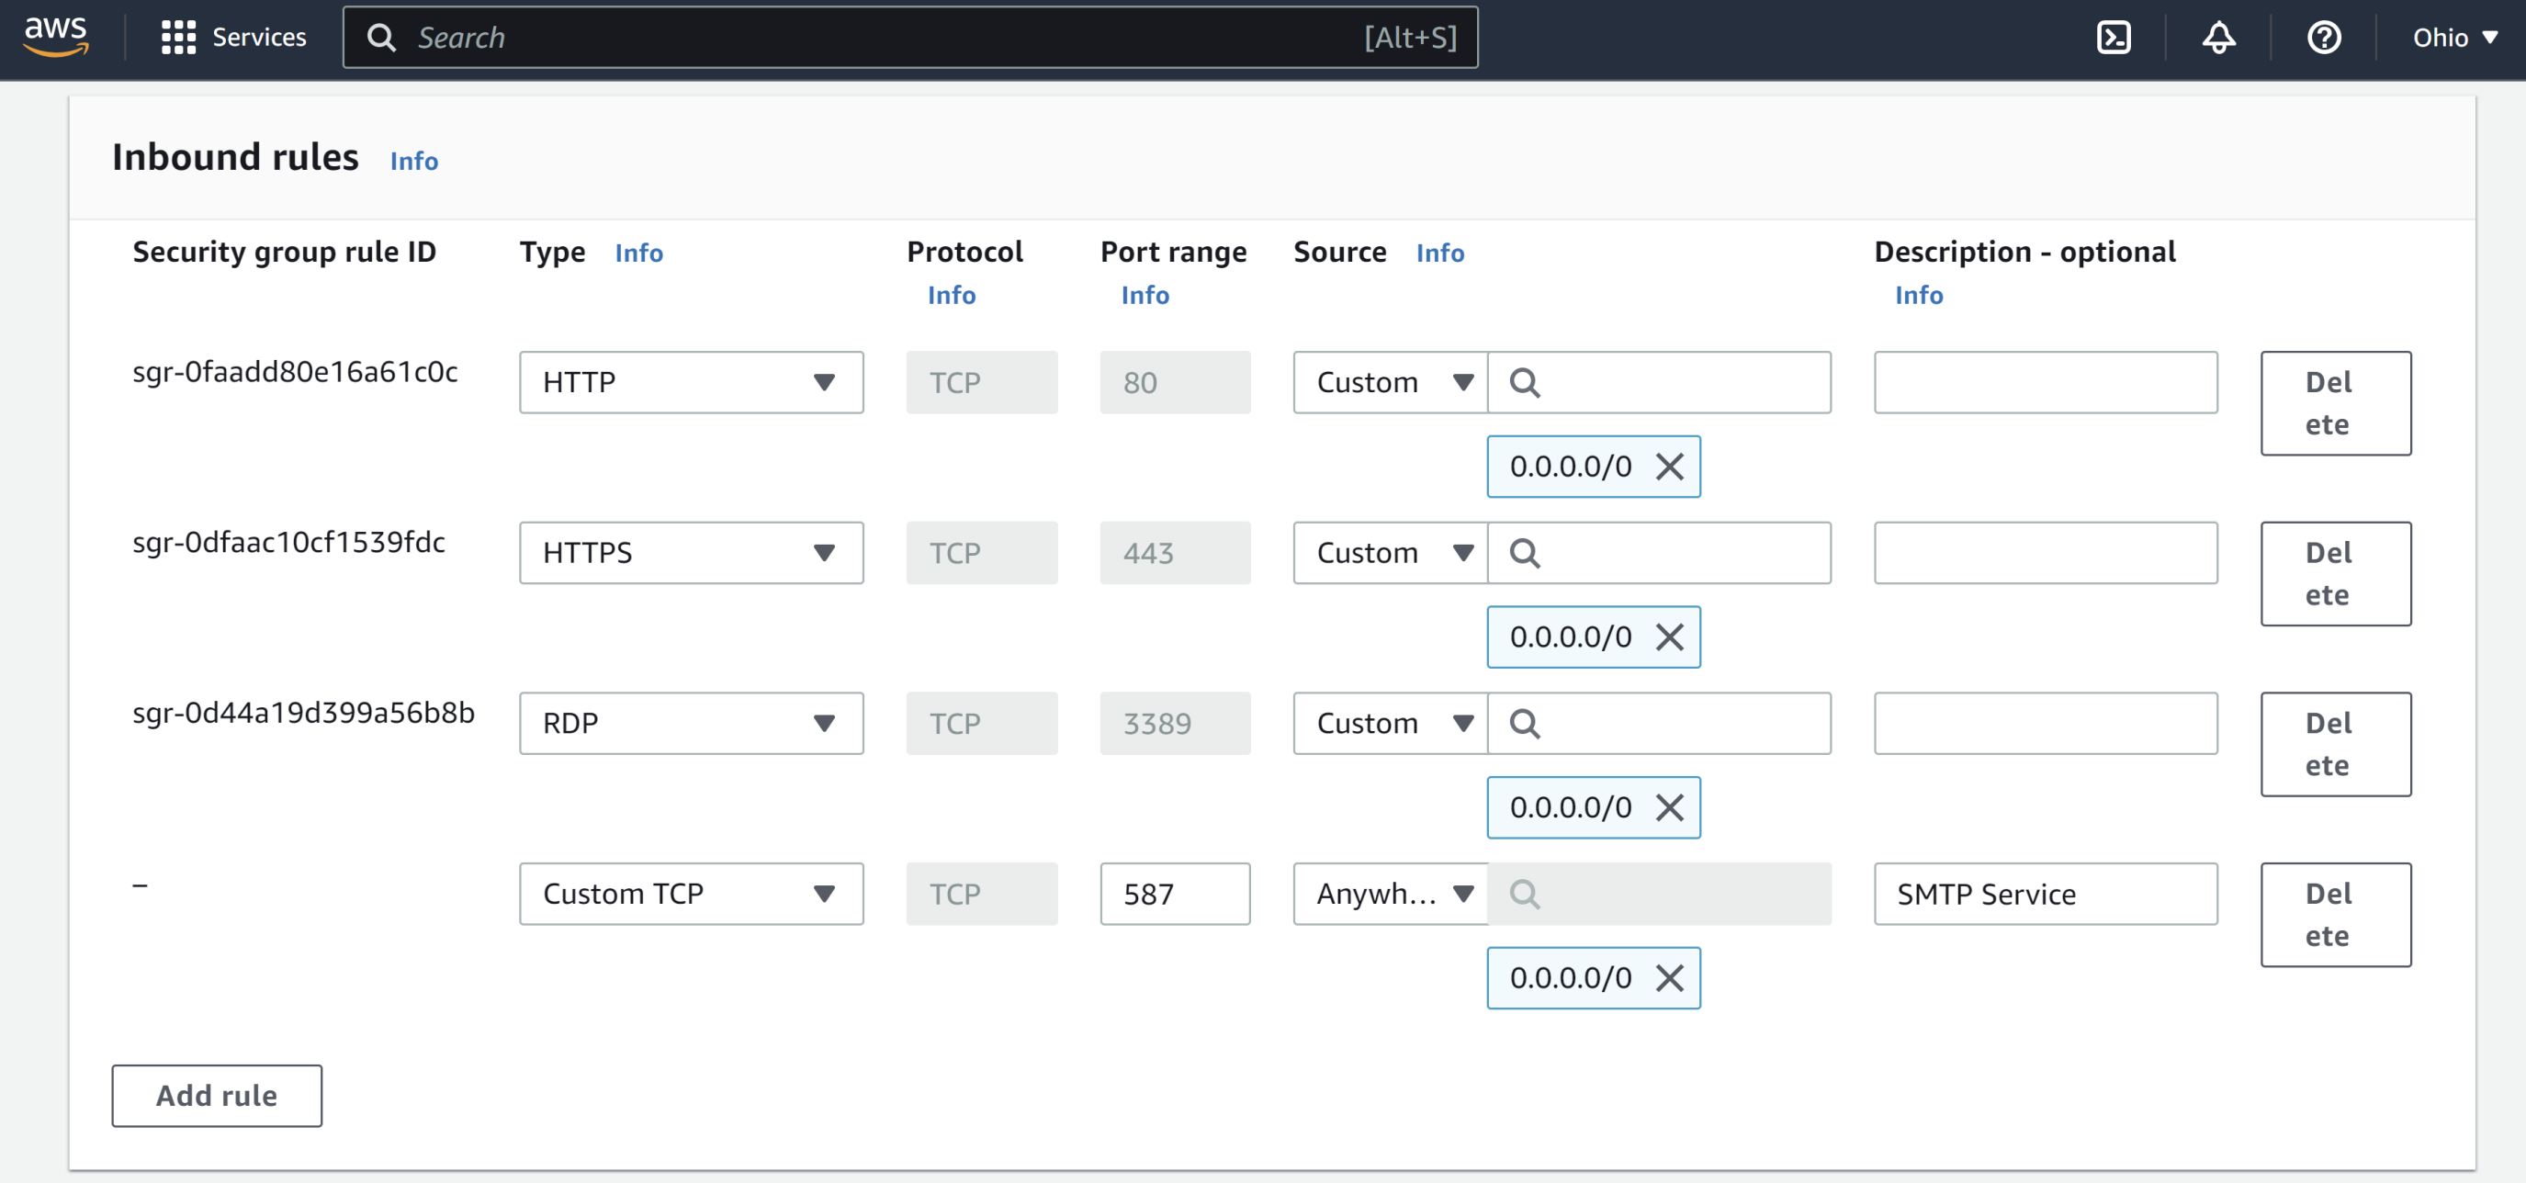
1. Enable Inbound Port 587 in Cloud Firewall

Slide 25
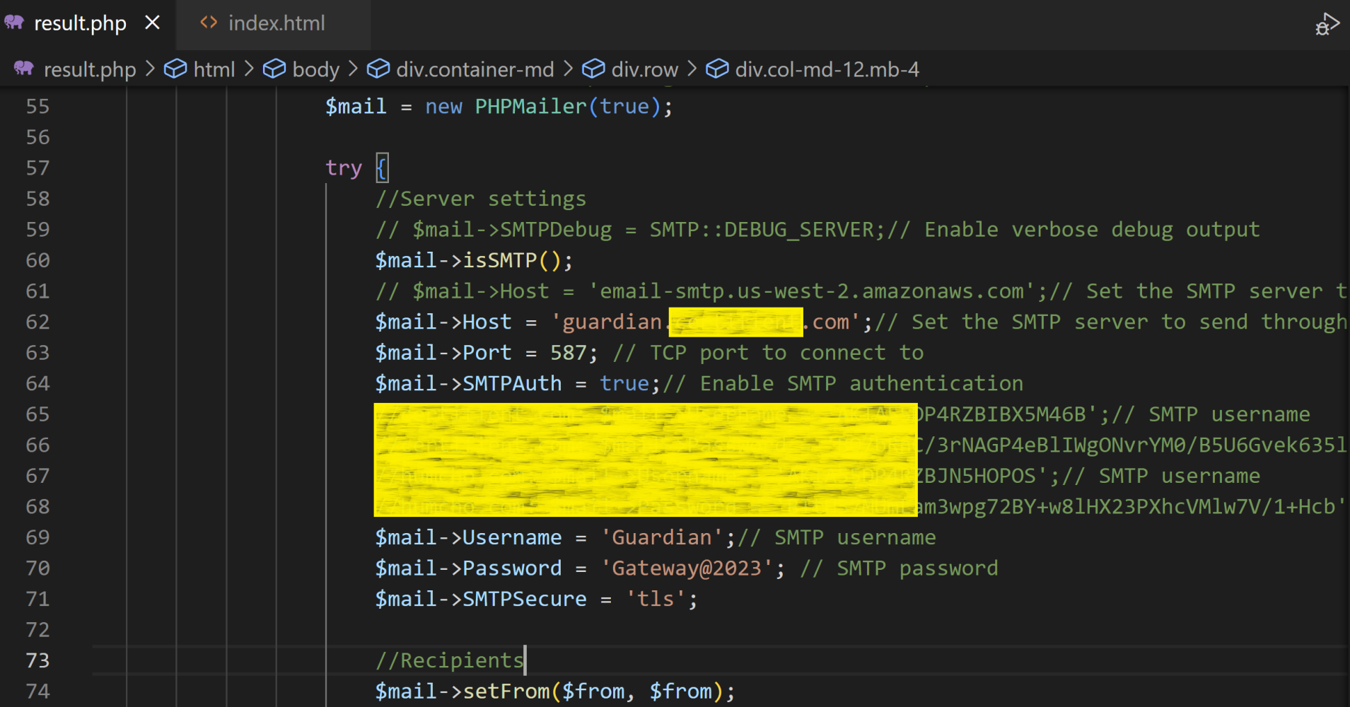
2. Send Test Message
Do not send from a local host. Otherwise an SSL error will occur.

Slide 26

Thank You & See You Again

